Slide 1
Building Apps with ArcGIS SDK for Android
Rama S Chintapalli

Slide 2
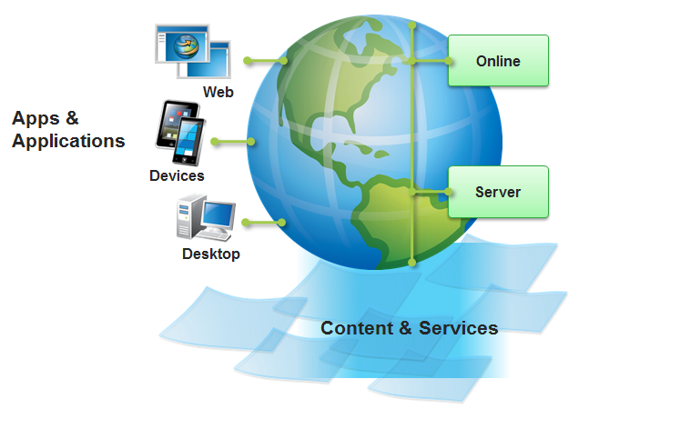
ArcGIS Platform ….

Slide 3



Getting Started ….
Download and Install eclipse, Eclipse 3.6.2 (Helios) and higher
(http://www.eclipse.org/downloads/)
Install the latest version ADT plug-in for Eclipse
(http://developer.android.com/sdk/installing/installing-adt.html)
Download the Android SDK (Version 2.3.3 or higher)
Install ArcGIS Runtime SDK for Android with Samples
(http://developers.arcgis.com/en/android/install.html)
… Your Hello World Map Sample should be ready in ~30 minutes

Slide 4

Building Blocks of the Application ….
Tasks: (Asynchronous)
Geocode / ReverseGeocode
Query
Identify
- Find
Geoprocessing
Routing
Editing
Map Controls:
MapView
Layers
~ Tiled, Dynamic, Graphic
~ OGC, OSM
- Symbols, Renderers, Pop ups
Mapping Application
ArcGIS.com:
Web Maps
Portal Access
OAuth View (Security)
Offline Data:
Local Tiled Layer
FeatureLayer
~ Editing
Geodatabase
~ Download
~ Synchronize
Routing
Local Query
Simplified API
Enhanced Graphics performance
Geotriggers API

Slide 5
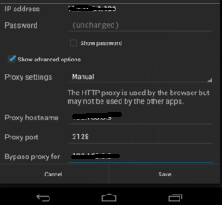
Debugging
On Windows On Mac
~ Fiddler ~ Charles
~ Proxy Port: 8888
~ Proxy Host: ipaddress of the connected machine

Slide 6
Developer Workshops
Day | Session | Location
Tuesday 10:15 – 11:30 | Windows Phone – Developing Apps | 17 B
Tuesday 1:30 – 2:45 | Java SE– Developing Apps | 17 A
Tuesday 1:30 – 2:45 | iOS – Developing Apps | 17 B
Tuesday 3:15 – 4:30 | Android - Developing Apps | 17 B
Wednesday 8:30 – 9:45 | Road Ahead – Runtime | 07 A/B
Wednesday 3:15 – 4:30 | OS X – Developing Apps | 17 A
Wednesday 3:15 – 4:30 | Windows Store – Developing Apps | 17 B
Thursday 10:15 – 11:30 | Qt – Developing Apps | 32 A
Thursday 3:15 – 4:30 | Road Ahead –Runtime | 06 A
Thursday 3:15 – 4:30 | WPF – Developing Apps | 17 B
Notes:
Add to presentations on Tuesday and Wednesday

Slide 7
Special Meetings
Day | Session | Location
Wednesday 12:00 – 1:00 | Mobile SIG | 04
Wednesday 5:30 – 7:00 | ArcPad User Group Meeting | 26 B
Esri Product Showcase
Day | Times | Location
Tuesday | 9:00 – 6:00 | Halls B, C, D
Wednesday | 9:00 – 6:00 * Family Night from 4:00 – 6:00 | Halls B, C, D
Thursday | 9:00 – 1:30 | Halls B, C, D
Demo Theatre Presentations all day long, every day…
Notes:
Add to presentations on Tuesday and Wednesday

Slide 8
Thank You
Q & A

